Slide 1
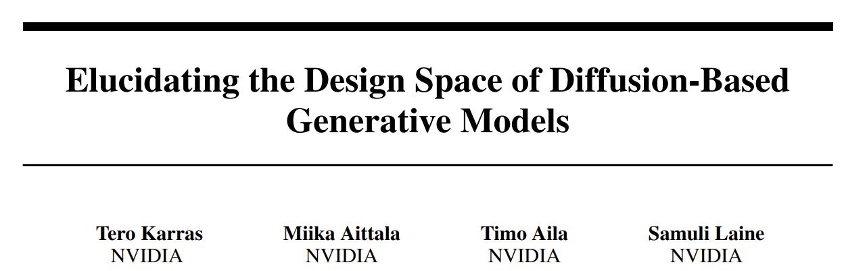
Diffusion model JC Introduction 1: SDE view
Manuel Gloeckler 02.10.24
Notes:
Hi everyone, my name is Manuel Glöckler, I'm a PhD student at the University of Tübingen, supervised by Jakob Macke.
Today I'm quite excited to tell you about our most recent work on simulation-based inference.
So, let's get started with that by first introducing the general problem, which is :simply put, inference on scientific simulators.

Slide 2
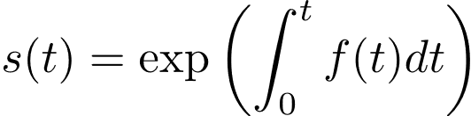
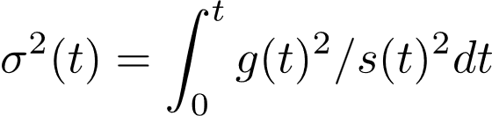
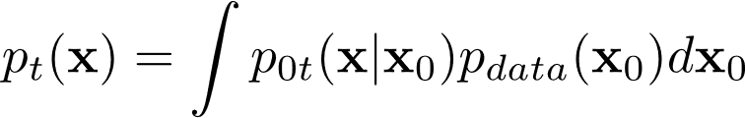
SDE view: Introduction
Appendix B1
All common diffusion models are based on linear time varying SDEs
Convenient because the perturbation kernels are known
But intractable marginals (in general)

Slide 3
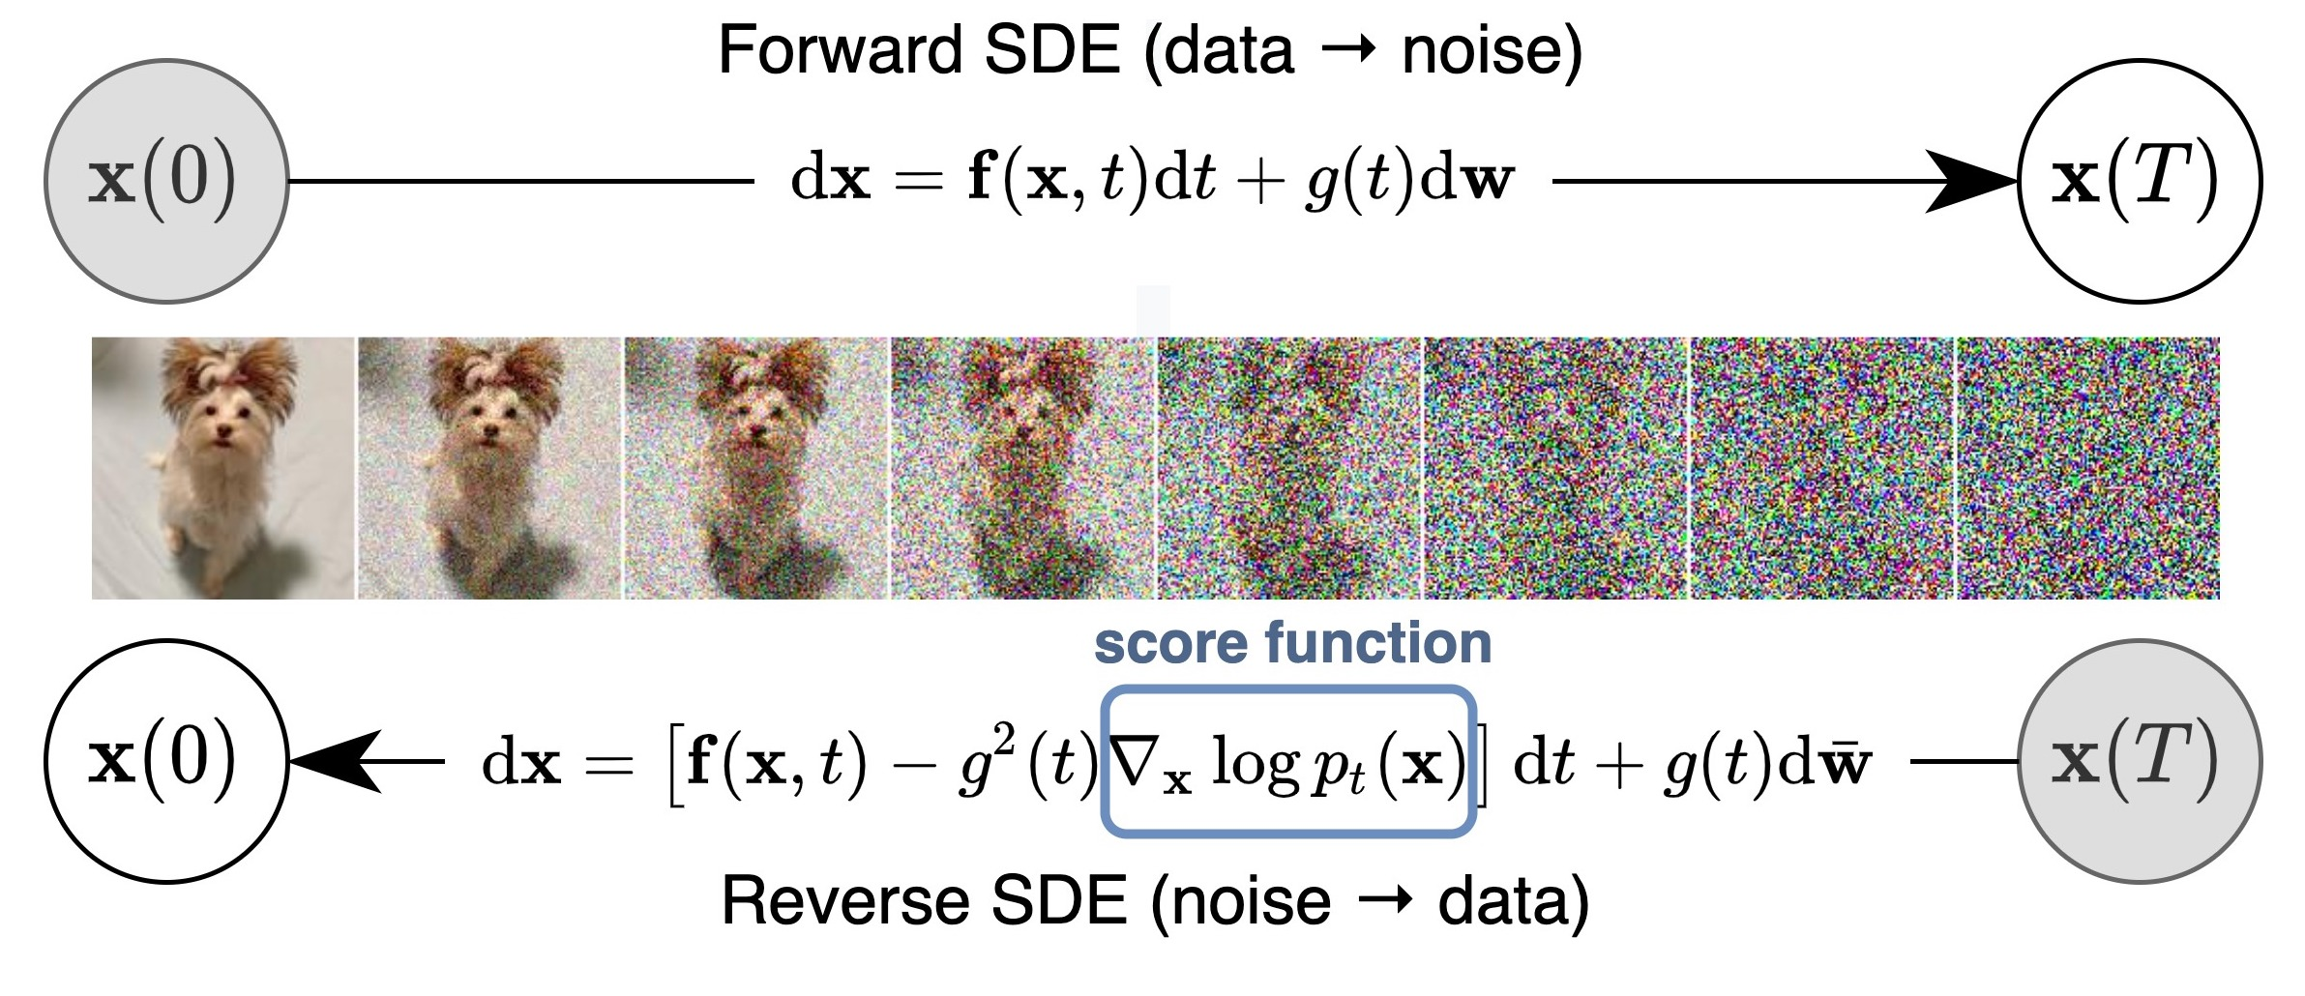
Anderson et.al. 1983
Song et. al 2020

Slide 4
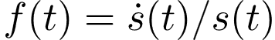
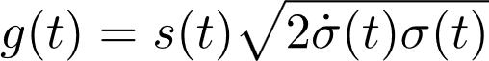
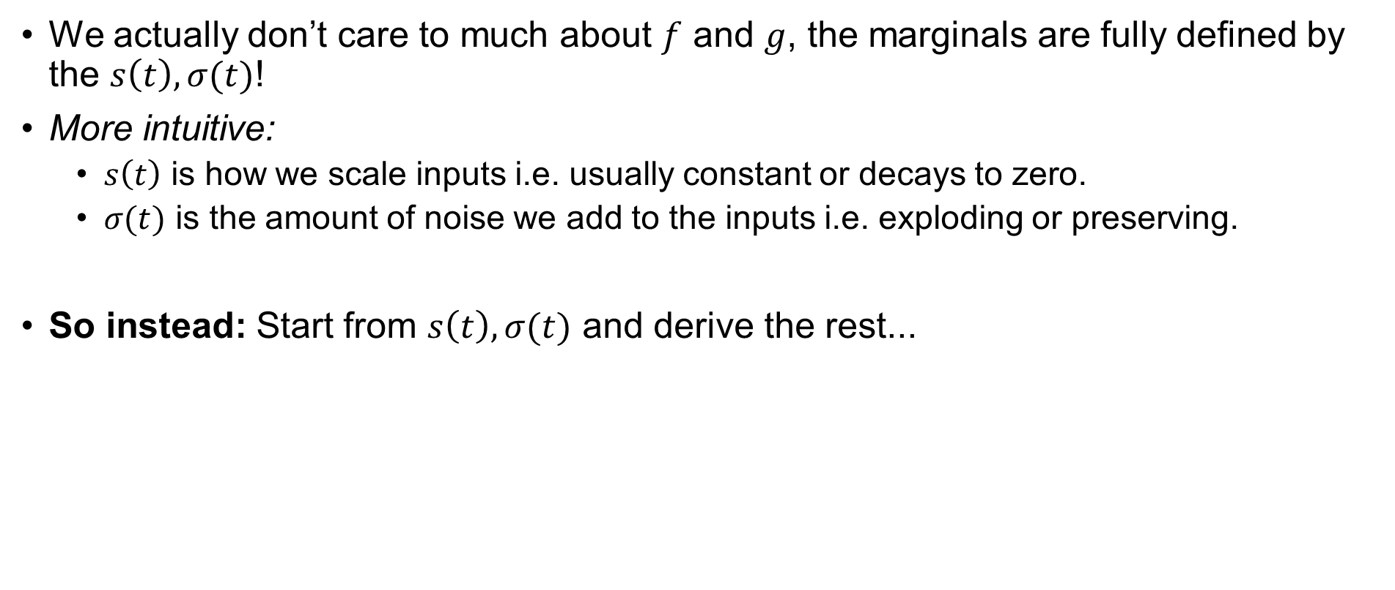
But all we need for that are the marginals…
We actually don’t care to much about $f$ and $g$, the marginals are fully defined by the $s\left(t\right), σ(t)$!
More intuitive:
$s\left(t\right)$ is how we scale inputs i.e. usually constant or decays to zero.
$σ(t)$ is the amount of noise we add to the inputs i.e. exploding or preserving.
So instead: Start from $s\left(t\right), σ(t)$ and derive the rest...

Slide 5


revere SDE
revere ODE
Song et. al. 2020
Karras et. al. 2022
revere SDE
(Appendix B5 i.e. finding a family of SDEs with same marginals using Fokker-Planck equations)
revere ODE
(Appendix B1, B2 plugin in the new expressions for drift and diffusion in previous reverse ODE)

Slide 6
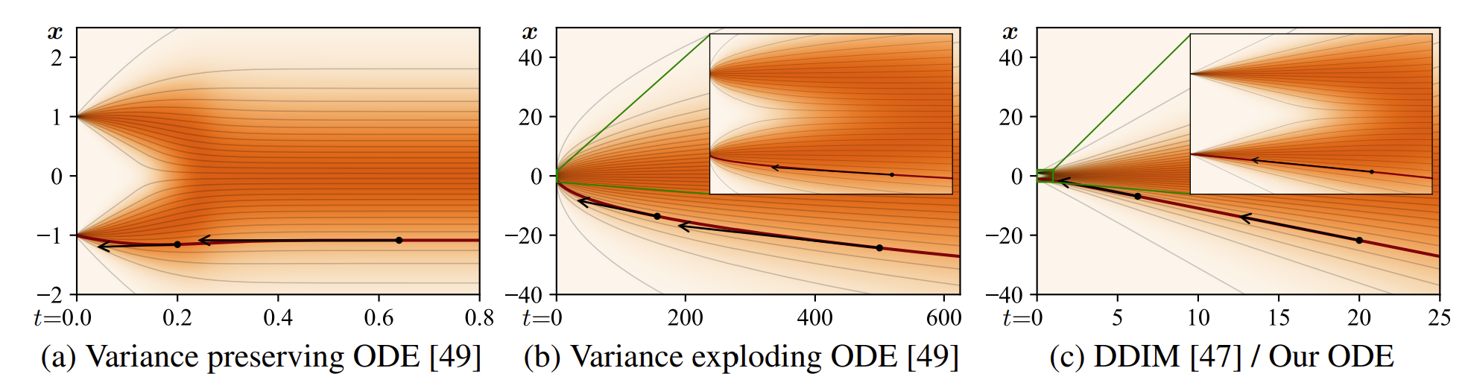
SDEs considered

Slide 7
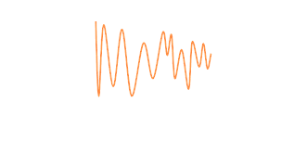
Training diffusion models…

Slide 8
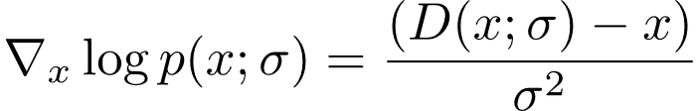
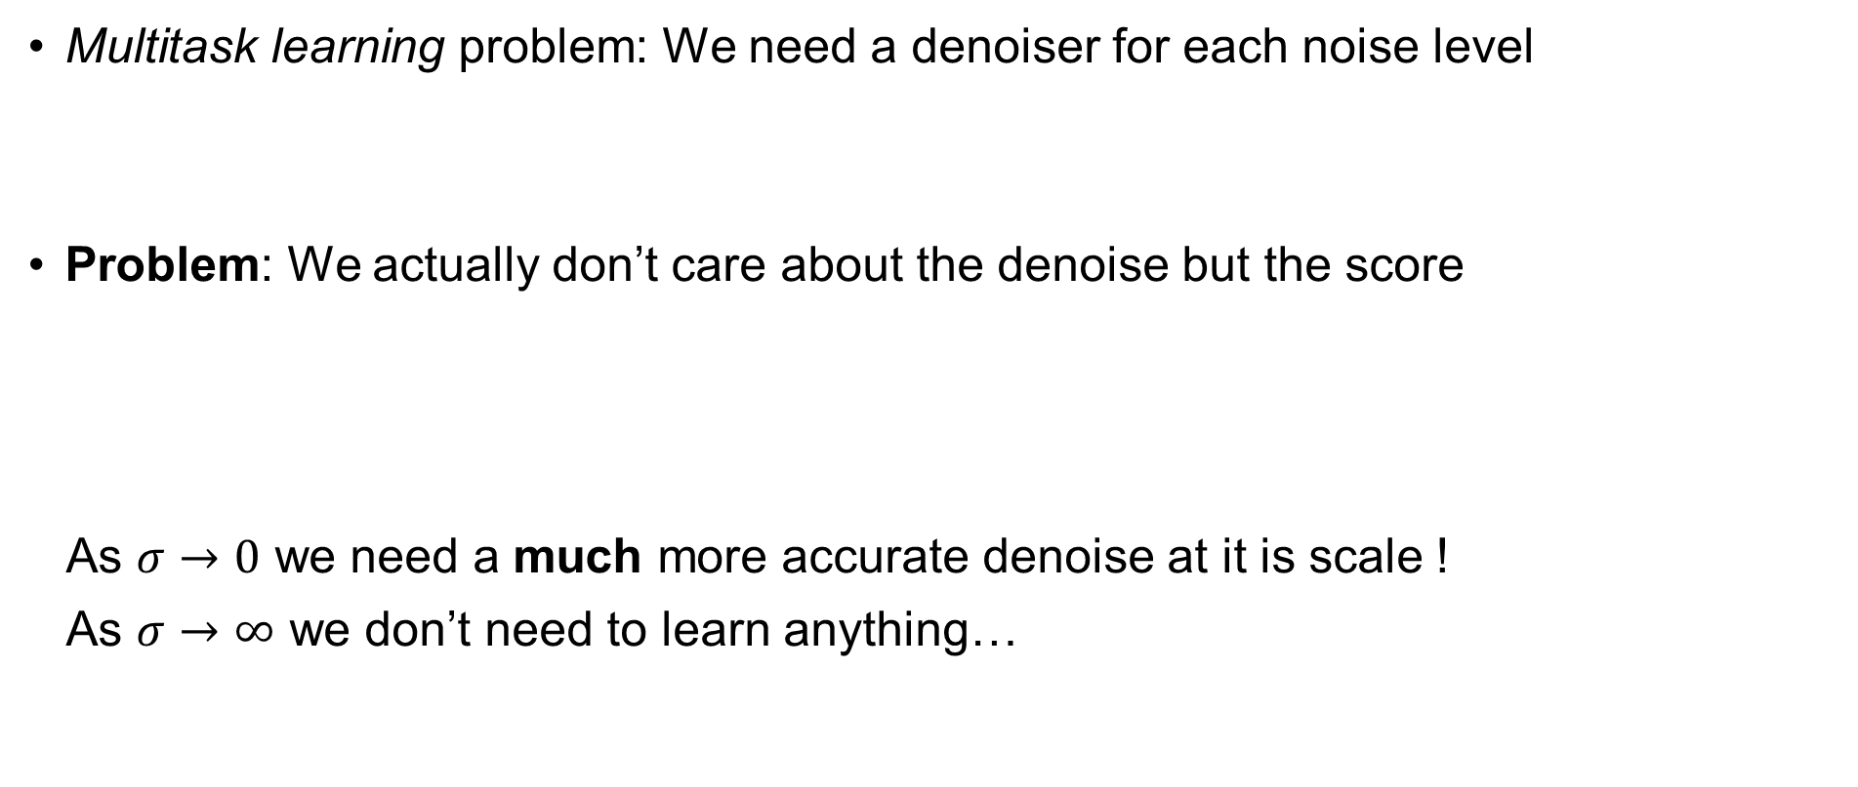
Problem with training diffusion models
Multitask learning problem: We need a denoiser for each noise level
Problem: We actually don’t care about the denoise but the score
As $σ→0$ we need a much more accurate denoise at it is scale !
As $σ→∞$ we don’t need to learn anything…
Tweedie's formula
Robbins et.al. 1956
~

Slide 9
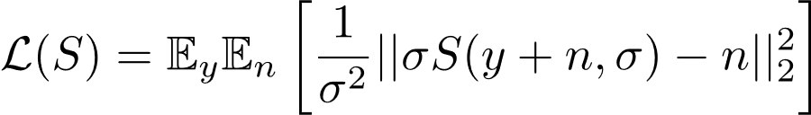
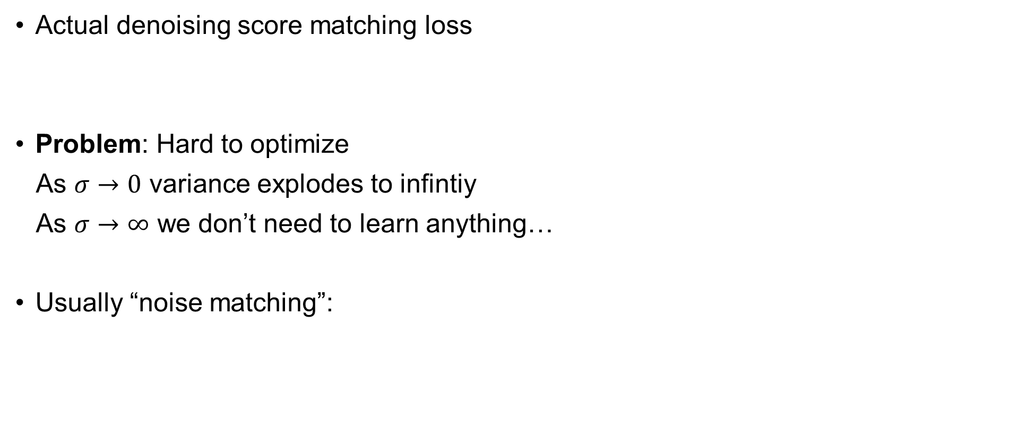
Problem with training diffusion models
Actual denoising score matching loss
Problem: Hard to optimize
As $σ→0$ variance explodes to infintiy
As $σ→∞$ we don’t need to learn anything…
Usually “noise matching”:
NOTE: Problem of denoising score matching, not score matching in general
Score matching (Hyvärin, 2005), Sliced Score matching (Song et. al. 2019)

Slide 10

Appendix B6
Denoiser

Slide 11

Appendix B6
Denoiser
Should be standardized

Slide 12
Denoiser
Effective target should have variance of one
Should be standardized

Slide 13


Denoiser
Minimize $c_{out}$
Effective target should have variance of one
Should be standardized

Slide 14

Denoiser
Minimize $c_{out}$
Effective target should have variance of one
Should be standardized

Slide 15

Denoiser
Minimize $c_{out}$
Effective target should have variance of one
Should be standardized
Kinda
arbirary
Effective target weight of one

Slide 16
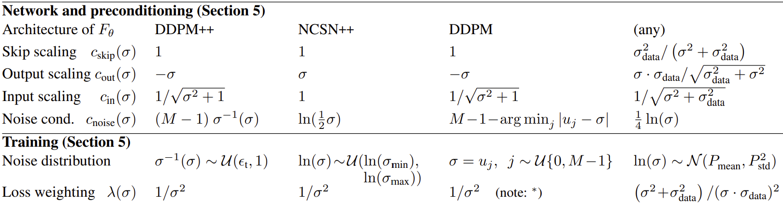
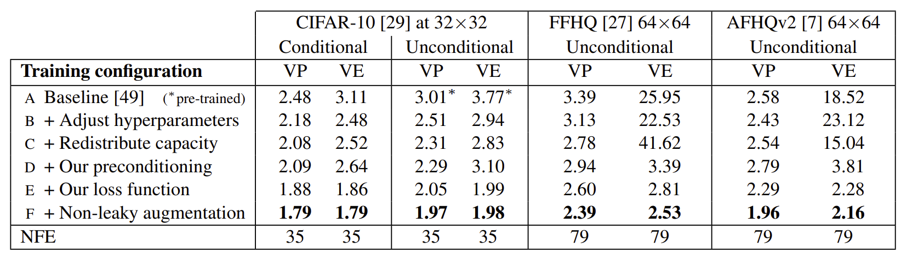
Improve training…

Slide 17
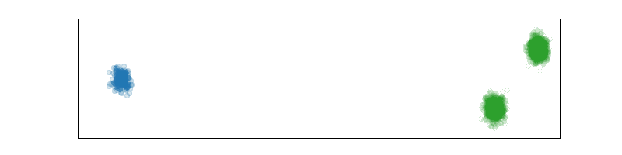
Sampling diffusion models…

Slide 18
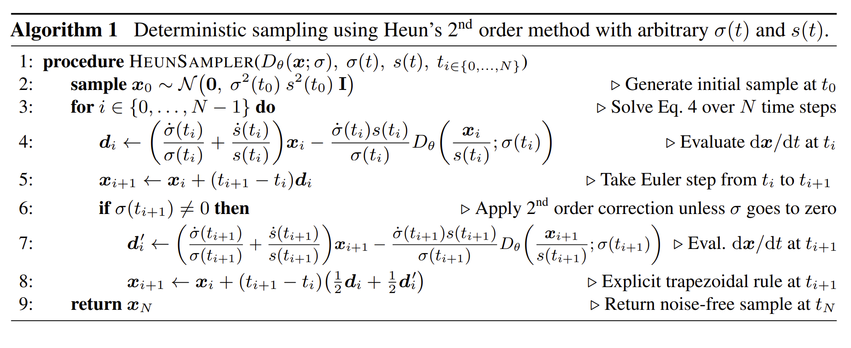
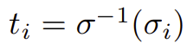
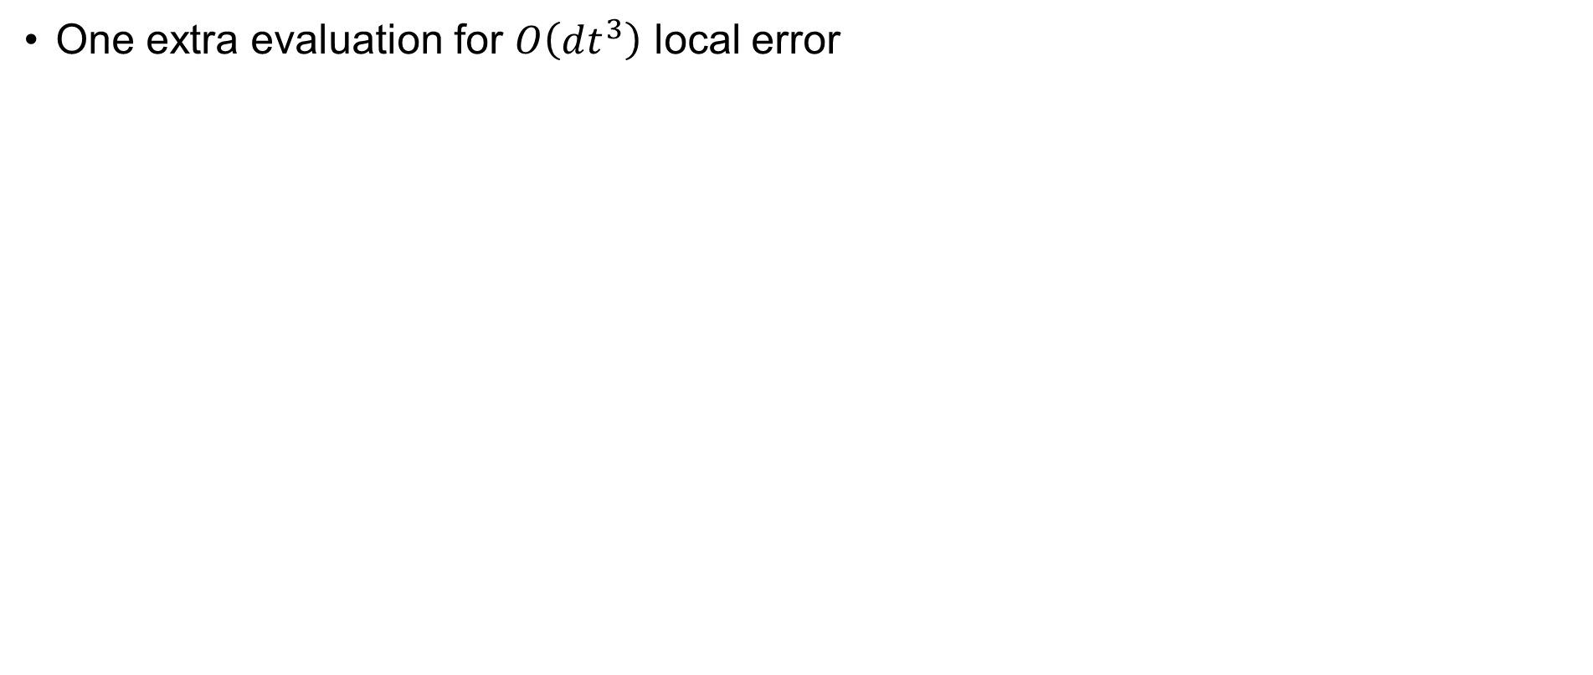
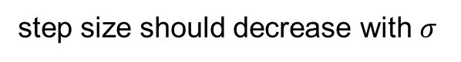
Deterministic sampling
One extra evaluation for $O\left(dt^{3}\right)$ local error
step size should decrease with $σ$

Slide 19
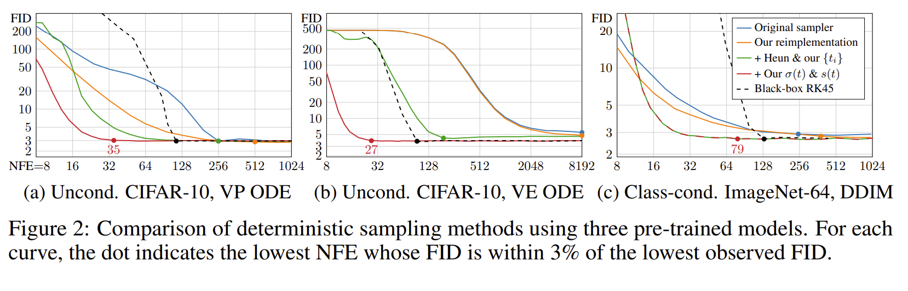
Sophisticated high order samplers are not worth the cost…

Slide 20
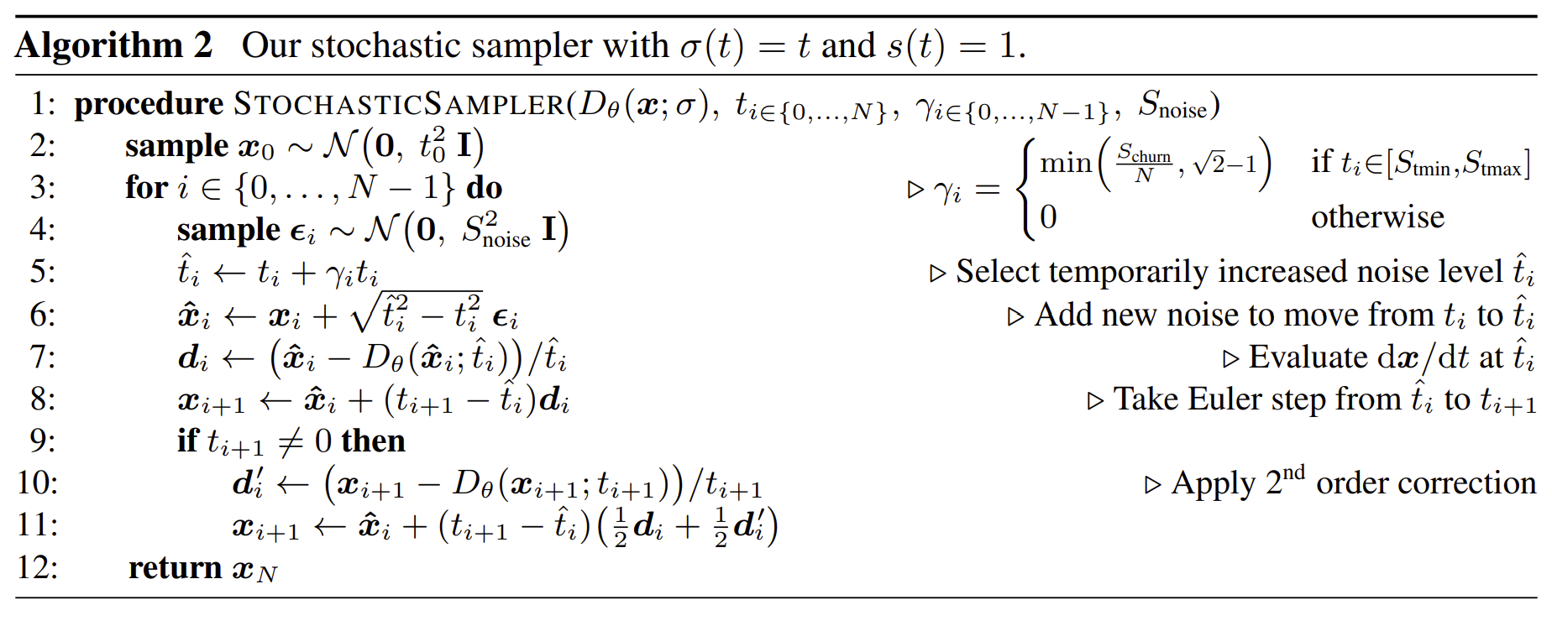
Stochastic sampler
Not a SDE solver, but an ODE integrator with Langevin-like steps according to some schedule.

Slide 21
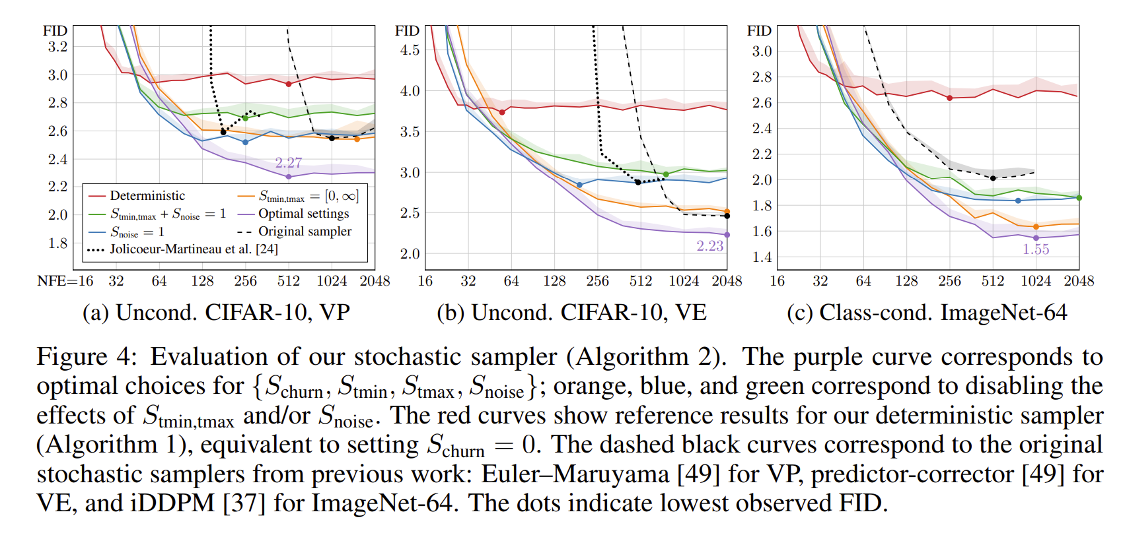
Stochastic sampler > Deterministic samplers

Slide 22
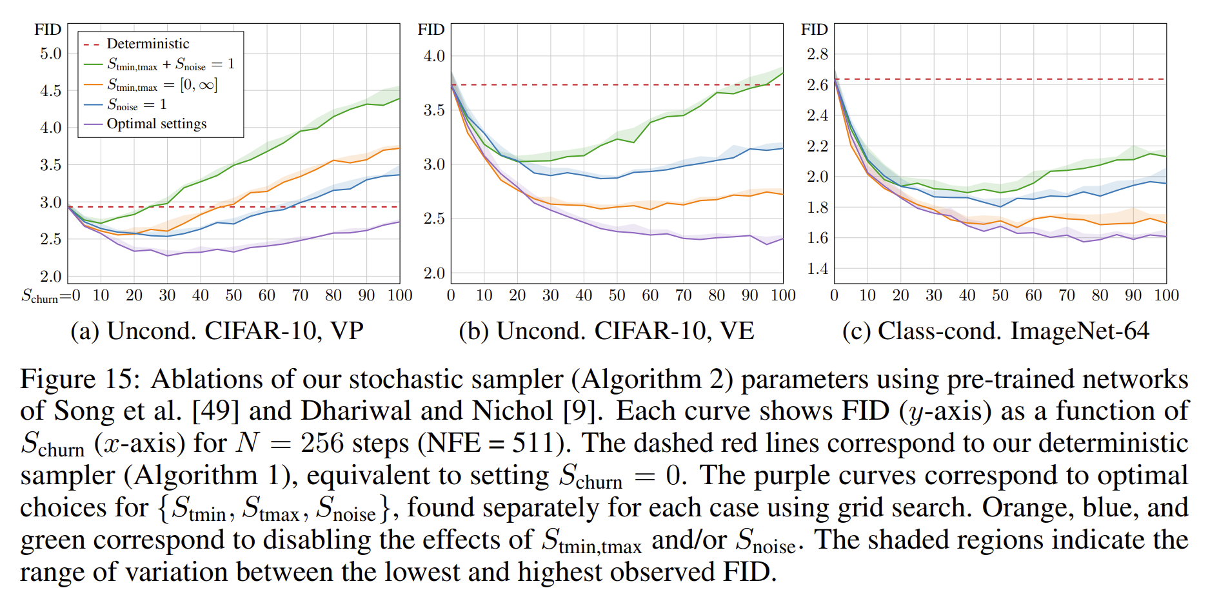
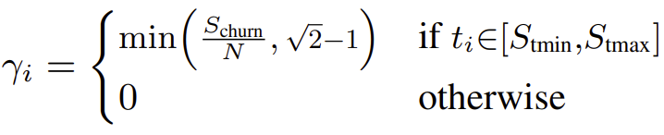
Stochastic sampler > Deterministic samplers

Slide 23
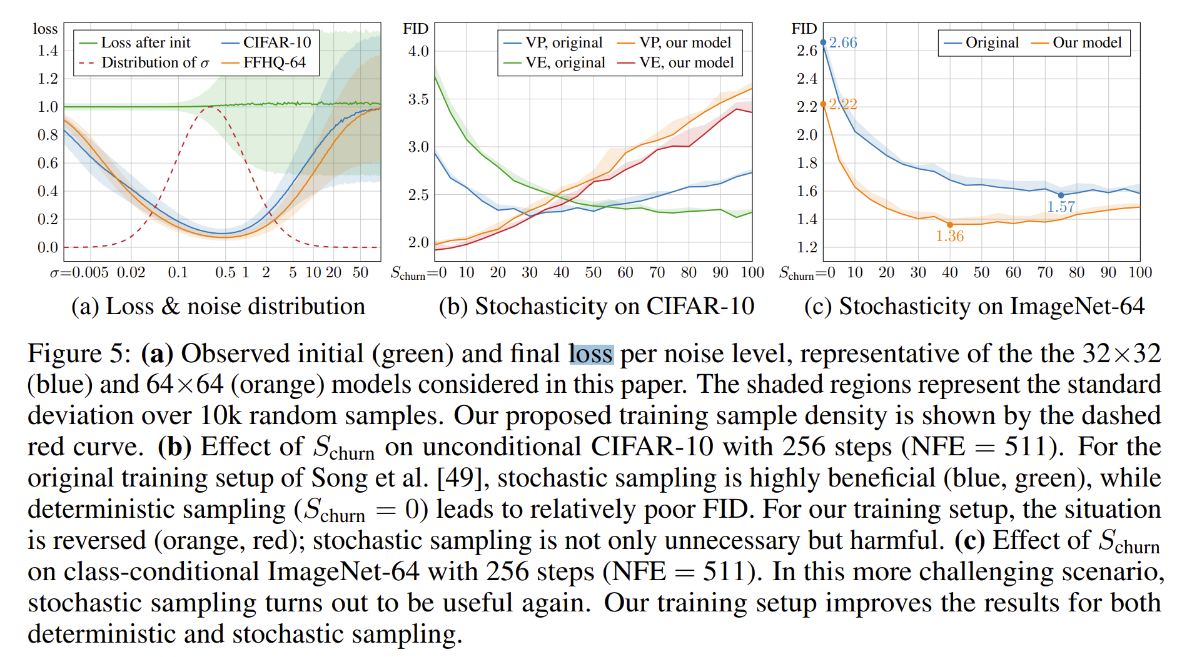
If trained good, deterministic samplers can be good

Slide 24
THE END

Slide 25
